Slide 1
SmartSync:
Accelerating Persistent HTM
by Minimizing Redundant Accesses
Notes:
The theme of our project is to accelerate HTM by reducing redundant access and optimize HTM performance.

Slide 2
Background
Transactional Memory (TM)
Persistent Hardware TM
Write-ahead Logging
Notes:
First, I will quickly introduce our project background, which is mainly divided into three part, transactional memory, Persistent Hardware Transactional memory, and write ahead logging.

Slide 3
Transactional Memory
TM（Transactional Memory），事务内存。
Find independent tasks in the algorithm
Map tasks to execution units (e.g. threads)
Define and implement synchronization among tasks
Parallel Programming
Avoid races and deadlocks, address memory model issues, …
Compose parallel tasks
Recover from errors
Ensure scalability
Manage locality
...
Notes:
The first is transactional memory. Its background is related to parallel programming. Parallel programming introduces a difficult problem. Between concurrent tasks, the read and write operations and write operations of the same variable require a synchronization mechanism to ensure its correctness. Many parallel programs use a lock mechanism or a semaphore mechanism. But these mechanisms make parallel programs difficult to design, program, debug, and generally perform poorly.

Slide 4
Transactional Memory
TM（Transactional Memory），事务内存。
Find independent tasks in the algorithm
Map tasks to execution units (e.g. threads)
Define and implement synchronization among tasks
Parallel Programming
Avoid races and deadlocks, address memory model issues, …
Compose parallel tasks
Transactional Memory
Recover from errors
Ensure scalability
Manage locality
...
Notes:
So Transactional Memory draws on the idea of ​​transaction in the database to deal with this problem of parallel programs. It encapsulates the access to shared variables in a transaction and manages it through a transaction conflict management mechanism.

Slide 5
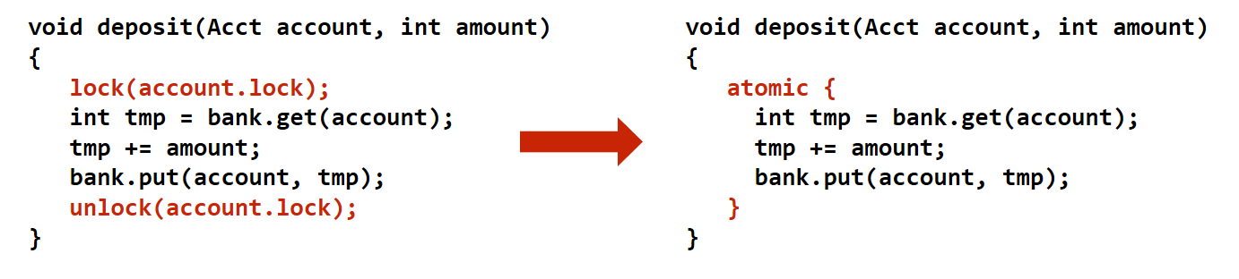
Transactional Memory
How
What
Notes:
This is an example of bank deposits. The code on the left uses lock, and the code on the right uses transactional memory. With lock, you need to know how to synchronize, such as when to obtain the lock and when to release the lock. This is a question of How.
With transactional memory, you only need to specify which parts need to be synchronized, and then include an atomic block, the system will transparently implement synchronization. This is a question of What

Slide 6
Persistent Hardware Transactional Memory
Hardware transactional memory
1. Versioned data is kept in caches
2. Conflict detection mechanisms built upon coherence protocol
Non-Volatile Memory
1. disk-like storage durability
2. DRAM-like access latency
13
Notes:
According to the difference between hardware implementation and software implementation, Transactional memory can be divided into hardware transactional memory and software transactional memory. HTM has better performance than STM. We only discuss HTM here.
The word Persistent is because we introduced non-volatile memory to provide persistence.

Slide 7
Write-ahead Logging
Requirement: Log is persisted prior to data
Categories: Undo Logging & Redo Logging & Undo+Redo Logging
13
Notes:
Transactional memory needs to manage two pieces of content, one is version management, to ensure crash consistency and the other is conflict management, which is used to detect and handle conflicts between things. Here we mainly focus on version management. A common strategy of version management is write-ahead logging.
For write-ahead logging, a very important limitation is that log must be written back to memory before data, so that when a failure occurs, the system can be restored to a consistent state.
According to the content of the data in the log, Write ahead logging can be divided into undo logging, redo logging, undo+redo logging.

Slide 8
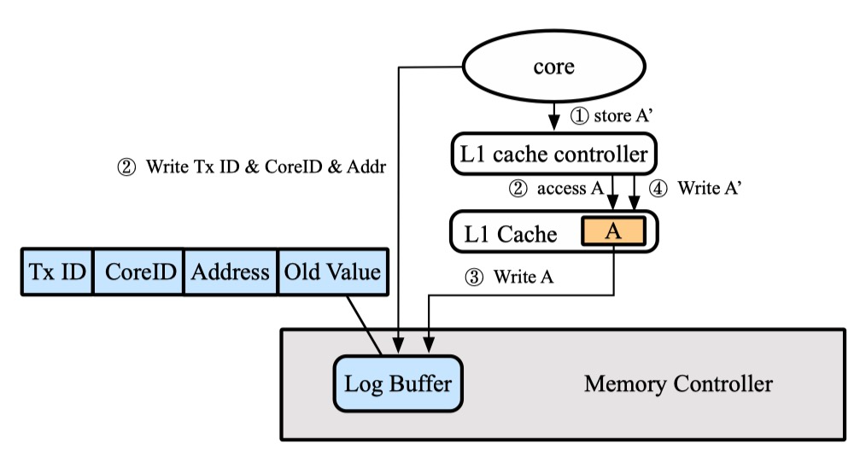
Limitation?
Logging eagerness: couple log generation and store instructions
Notes:
以前的方法都对undo, redo, undo+redo logging做了不同的改进，但是我们发现了一个他们共同的问题，并将其归纳为logging eagerness。他们都把log的生成和store指令耦合在一起。为了保证log先于data写回，在接收到store指令后, 系统会立刻生成log，写回memory controller，然后再来更新cache中的数据。这种eagerness使得store指令和其他很多额外的操作绑定在一起，增加了store的执行时间。
如图所示，这里我们使用的是undo log。在接收到store指令后，系统需要收集meta-log的信息对应图中第一步，访问cache 获取undo value,对应图中第二步，将undo value写回memory controller，对应图中第三步。然后第四步才把数据更新到cache中。
同时因为不经过cache直接把log写回memory controller浪费了cache的时间局部性和空间局部性。这增加了整合log的难度

Slide 9
Limitation?
Logging eagerness: couple log generation and store instructions
Notes:
The previous methods have made different improvements to undo, redo, undo+redo logging, but we found a common problem with them and summarized it as logging eagerness. They all couple log generation and store instructions together. To ensure that the log is written back before the data, after receiving the store command, the system will immediately generate the log, write it back to the memory controller, and then update the data in the cache. This eagerness binds the store instruction with many other additional operations, increasing the execution time of the store. As shown in the figure, here we are using undo log. After receiving the store command, the system needs to collect meta-log information corresponding to the second step in the figure, accessing the cache to obtain the undo value, corresponding to the second step in the figure, and writing the undo value back to the memory controller, corresponding to the third step in the figure. Then the data is updated to the cache in the fourth step.
At the same time, writing the log back to the memory controller directly without going through the cache wastes the time and space locality of the cache. This increases the difficulty of integrating log

Slide 10
Limitation?
Logging eagerness: couple log generation and store instructions
Notes:
以前的方法都对undo, redo, undo+redo logging做了不同的改进，但是我们发现了一个他们共同的问题，并将其归纳为logging eagerness。他们都把log的生成和store指令耦合在一起。为了保证log先于data写回，在接收到store指令后, 系统会立刻生成log，写回memory controller，然后再来更新cache中的数据。这种eagerness使得store指令和其他很多额外的操作绑定在一起，增加了store的执行时间。如图所示，这里我们使用的是undo log。在接收到store指令后，系统需要收集meta-log的信息对应图中第二步，访问cache 获取undo value,对应图中第二步，将undo value写回memory controller，对应图中第三步。然后第四步才把数据更新到cache中。
同时因为不经过cache直接把log写回memory controller浪费了cache的时间局部性和空间局部性。这增加了整合log的难度

Slide 11
Limitation?
Logging eagerness: couple log generation and store instructions
Notes:
以前的方法都对undo, redo, undo+redo logging做了不同的改进，但是我们发现了一个他们共同的问题，并将其归纳为logging eagerness。他们都把log的生成和store指令耦合在一起。为了保证log先于data写回，在接收到store指令后, 系统会立刻生成log，写回memory controller，然后再来更新cache中的数据。这种eagerness使得store指令和其他很多额外的操作绑定在一起，增加了store的执行时间。如图所示，这里我们使用的是undo log。在接收到store指令后，系统需要收集meta-log的信息对应图中第二步，访问cache 获取undo value,对应图中第二步，将undo value写回memory controller，对应图中第三步。然后第四步才把数据更新到cache中。
同时因为不经过cache直接把log写回memory controller浪费了cache的时间局部性和空间局部性。这增加了整合log的难度

Slide 12
Limitation?
Logging eagerness: couple log generation and store instructions
Notes:
以前的方法都对undo, redo, undo+redo logging做了不同的改进，但是我们发现了一个他们共同的问题，并将其归纳为logging eagerness。他们都把log的生成和store指令耦合在一起。为了保证log先于data写回，在接收到store指令后, 系统会立刻生成log，写回memory controller，然后再来更新cache中的数据。这种eagerness使得store指令和其他很多额外的操作绑定在一起，增加了store的执行时间。如图所示，这里我们使用的是undo log。在接收到store指令后，系统需要收集meta-log的信息对应图中第一步，访问cache 获取undo value,对应图中第二步，将undo value写回memory controller，对应图中第三步。然后第四步才把数据更新到cache中。
同时因为不经过cache直接把log写回memory controller浪费了cache的时间局部性和空间局部性。这增加了整合log的难度

Slide 13
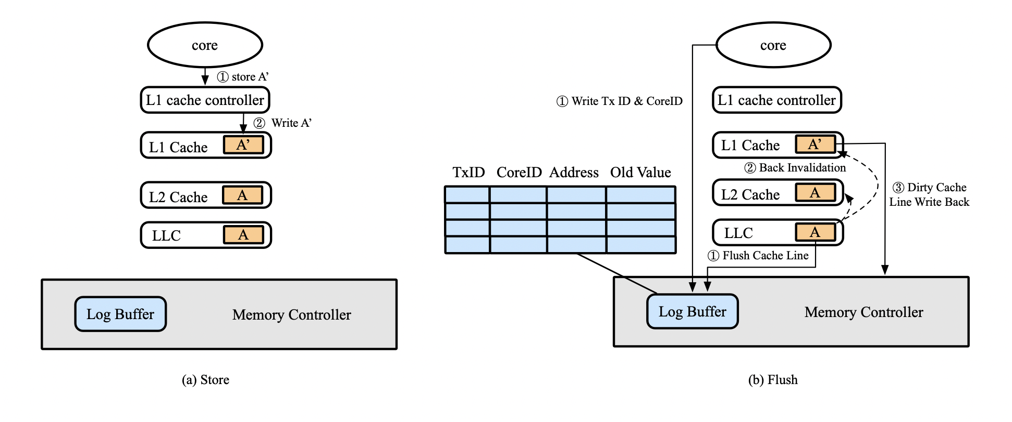
Lazy Logging
Notes:
We believe that eager logging is not only unnecessary, but also damages performance, so Lazy Logging is proposed.
Decouple the generation of log from store instructions and couple it with cache line eviction. When the data is evicted out of the cache and written back to the memory, the log will be generated.
The figure on the left is the processing of the store command. After receiving the store command, the cache can be updated immediately. The figure on the right is the process of log generation. We use undo log. In the first step, the value in the last level cache is used as the undo log value to be evicted out and written back to the memory controller through the flush command. At the same time, the CPU sends meta-log information to the log buffer. In the second step, because we use the inclusive (inclusive, shared and exclusive corresponding) cache, the eviction in the Last level cache will cause it to send invalidate signals to the L1 and L2 caches. Then in the third step, the new value in the L1 cache corresponding to the undo value is written back to the memory controller.

Slide 14
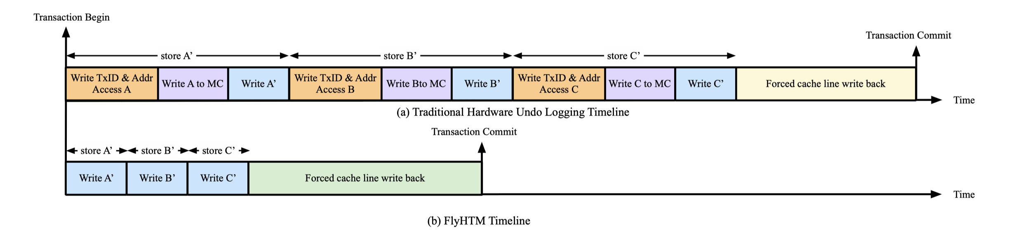
Lazy Logging
Shortened execution of store instructions.
Inherent support of log coalescing.
Notes:
Our method has two advantages, the first is that we cut off the extra operations brought to the store instruction due to the coupling with log generation, and shortens the execution time of the store instruction. The other is that our design naturally supports log coalescing. The design of Lazy logging and flush cache line allows us to benefit from the space and time locality of the cache respectively. And LLC can help log coalescing.

Slide 15
Progress
Read previous work and find potential limitations
Design the optimization method and make a theoretical comparison
Learn gem5 and the experiment setup (Workloads and benchmark)
Now: implement our design and test it in experiment
Notes:
At present, the progress of our entire project timeline, the completed part includes the latest papers mentioned above, and summarizes the potential optimization space, which is eager logging; design optimization methods, and theoretically analyze why it is optimized; Then the parts not mentioned above, because we need to optimize and do test experiments in the future, we learned the use of gem5 hardware simulator and are basically familiar with the settings of subsequent experiments, such as which micro-benchmarks or macro-benchmarks need to be tested; At present, our main work is to realize our optimization ideas and make actual tests.

Slide 16
Progress
Read previous work and find potential limitations
Design the optimization method and make a theoretical comparison
Learn gem5 and the experiment setup (Workloads and benchmark)
Now: implement our design and test it in experiment
Number of logs | 65
Number of writes | 40000
Notes:
Now it is basically determined what parts of gem5's HTM code implementation need us to extend and modify. At the same time, based on the principle of lazy logging we put forward, we did a preliminary test to find the number of logs and the number of writes to be written by our design. It can be seen that the number of logs here is much smaller than the number of writes, and the effect is significant.

Slide 17
Plan
Experiment： conduct multiple experiments on the basis of the existing plan, and conduct data processing and statistics
Writing the paper：February 2021 to April 2021
Paper publication ：April 2021 to May 2021
Notes:
Then here is our follow-up plan. The main task is to continue to implement the complete optimization scheme and conduct experiments. At present, we have also completed the theoretical part of the paper, and then a complete paper will be formed later.

Slide 18
Thanks.
Notes:
That’s all , thank you for listening!

